Slide 1
Many equations, one solution
Solving linear equations

Slide 2
how to use Oak lessons

Slide 3
I can understand that a family of linear equations can all have the same solution.

Slide 4
An equation is used to show two expressions that are equal to each other.
A solution to an equality with one variable is a value for the variable which, when substituted, maintains the equality between the expressions.

Slide 5

Many equations, one solution
Maintaining equality while manipulating equations
Generating equations with the same solution

Slide 6
Maintaining equality while manipulating equations
If we know two expressions are equal we can form an equation.
If we perform the same operation to both expressions they remain equal to each other.
8 + 4 = 12
+ 1
8 + 4 + 1 =
12 + 1
8 + 4 + 1 = 13
We know that 8 + 4 and 12 are equal to each other.
What happens if I add 1 to the expression on the left hand side?
It is no longer equal to 12
What would we need to do to the right hand side to maintain equality?
Add 1 to 12 as well.

Slide 7
Maintaining equality while manipulating equations
What would I need to do to maintain equality this time?
8 + 4 = 12
+ 1
+ (−10)
8 + 4 + (−10) =
12 + (−10)
8 + 4 + 1 =
12 + 1
8 + 4 −10 = 2
8 + 4 + 1 = 13
We can check that we have maintained equality by seeing if both sides of the equation are still equal.
8 + 4 −10 = 2
12 −10 = 2
2 = 2
Yes, we have maintained equality.
This equation is equivalent to our initial equation.

Slide 8
Maintaining equality while manipulating equations
What will happen if I double the expression on the right hand side?
8 + 4 = 12
× 2
(8 + 4) × 2
=12 × 2
8 + 4 + 1 = 24
2(8 + 4)
What would we need to do to maintain equality?
Multiply the whole expression on the left hand side by 2
Notice that brackets are necessary to ensure the whole expression is multiplied by 2
Convention is to write the multiplier at the front of the bracket.

Slide 9
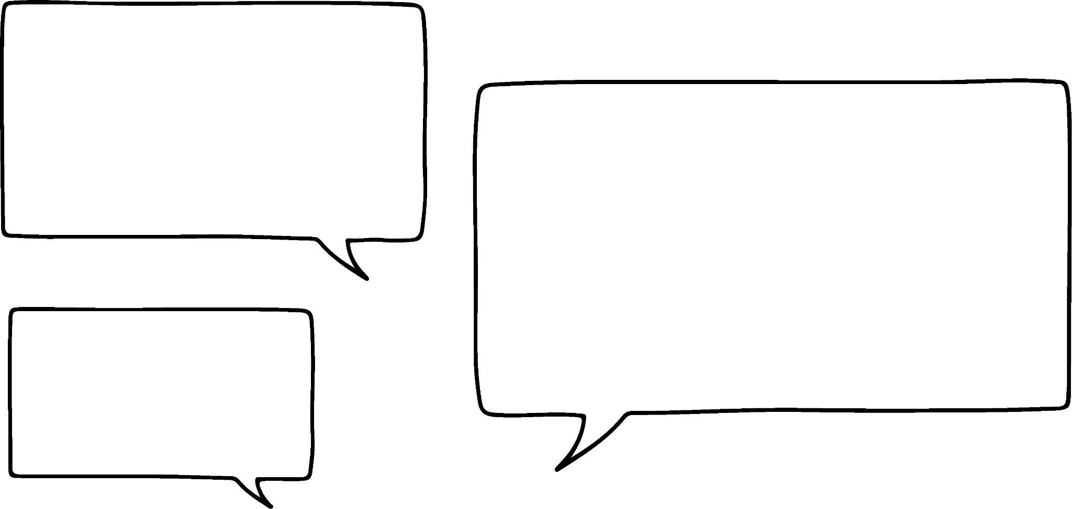


Maintaining equality while manipulating equations
What will happen if I double the expression on the right hand side?
To check we could calculate 8 + 4 then multiply by 2
8 + 4 = 12
× 2
(8 + 4) × 2
=12 × 2
Laura
8 + 4 + 1 = 24
2(8 + 4)
We should do 2 × 8 and 2 × 4 and add them together.
2 × 8 + 2 × 4 = 24
16 + 8 = 24
24 = 24
(8 + 4) × 2 = 24
12 × 2 = 24
24 = 24
Alex
Do you agree with either statement?
Both methods work and show that we have maintained equality. Alex uses the distributive property and Laura evaluates according to the priority of operations.

Slide 10
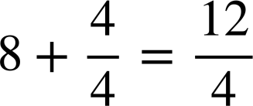
Maintaining equality while manipulating equations
What mistake has been made here? How could you show that equality has not been maintained?
8 + 4 = 12
÷ 4
8 + 4 ÷ 4 = 12 ÷ 4
The whole expression on the left hand side should be divided by 4 not just the 4
The LHS evaluates to 8 + 1 = 9 and the right hand side evaluates to 3

Slide 11
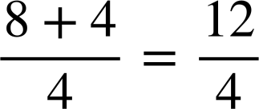
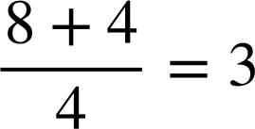
Maintaining equality while manipulating equations
Dividing the equation by 4 should look like this:
8 + 4 = 12
÷ 4
(8 + 4) ÷ 4 = 12 ÷ 4

Slide 12
Maintaining equality while manipulating equations
We can do the same thing with equations that have variable terms.
This is an equation where the solution is clearly when x is 5
x = 5
+ 3
+ (−7)
+ x
x + (−7) =
5 + (−7)
x + 3 =
5 + 3
x + x =
5 + x
x − 7 = −2
x + 3 = 8
2x = x + 5
We can create an equivalent equation by adding the same value to both sides of the initial equation.

Slide 13


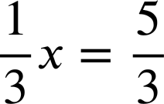
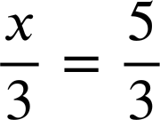
Maintaining equality while manipulating equations
We can also create equivalent equations by multiplying both sides of the equation by the same value.
x = 5
× 3
× (−4)
×
x × (−4) =
5 × (−4)
x × 3 =
5 × 3
−4x = −20
3x = 15
x × =
5 ×
As multiplying by a third is the same as dividing by 3, this could also be written as:

Slide 14
Maintaining equality while manipulating equations
Complete the diagram:
x = −18
× 2
÷ (−6)
+ 9
x ÷(−6) =
(−18) ÷(−6)
x × 2 =
(−18) × 2
=
=
=
=

Slide 15

Maintaining equality while manipulating equations
Complete the diagram:
x = −18
× 2
÷ (−6)
+ 9
x ÷(−6) =
(−18) ÷(−6)
x × 2 =
(−18) × 2
x + 9
(−18) + 9
=
3
2x
=
−36
=
x + 9
−9
=

Slide 16
Maintaining equality while manipulating equations
The initial equation in the centre of our diagram has a solution when x is 5. Therefore, all the equivalent equations will have a solution of x = 5
3 × (5) = 15
15 = 15
−4 × (5) = −20
−20 = −20
−4x = −20
3x = 15
× (−4)
× 3
(5) + 3 = 8
8 = 8
x = 5
+ 3
+ (−7)
x + 3 = 8
+ x
x − 7 = −2
2x = x + 5
2 × (5) = (5) + 5
10 = 10
(5) − 7 = −2
−2 = −2
We can substitute the solution (5) in each equation to check.

Slide 17
Maintaining equality while manipulating equations
We can perform multiple operations to an equation. As long as we perform the same operation to the expressions on both sides of the equation, we will maintain equality.
2(x + 3) = 22
× 2
22
x + 3 = 11
2x + 6 =
+ 3
x = 8
Using brackets ensures the whole expression is being multiplied by 2
We can expand the brackets by multiplying every term by 2 if we wish.
When expanding brackets, no operation has been performed, the expression is just written in a different format. The right hand side remains the same.

Slide 18
Maintaining equality while manipulating equations
× 3
3(2x + 3)
= 57
2x + 3 = 19
6x + 9 = 57
+ 3
2x = 16
× 2
x = 8
How would we maintain equality for this next step?
The whole expression should be multiplied by 3
This is the same as multiplying each term by 3

Slide 19
Maintaining equality while manipulating equations
(2x + 3) + 3 = 19 + 3
+ 3
2x + 6 = 22
2x + 3 = 19
+ 3
2x = 16
× 2
x = 8
How would we maintain equality if the next step was + 3 instead?
Adding 3 to the whole expression is the same as adding 3 to the constant term.

Slide 20

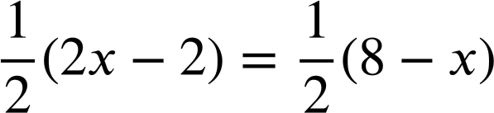
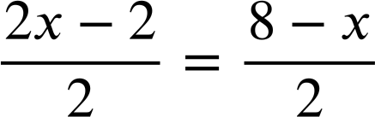
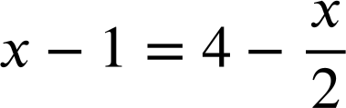
Maintaining equality while manipulating equations
You can start with more complex equations too.
×
2(3x + 1) = 22
2x − 2 = 8 − x
× 2
3x + 1 = 11
+ (−x)
or 6x + 2 = 22
+ 3
3x − 2 = 8
× 5
Multiplying by a half is the same as dividing by 2.
5(3x − 2) = 40
+ 2x
Each term can be divided by 2 separately if we wish.
5(3x − 2)+ 2x = 40 + 2x
or 17x − 10 = 40 + 2x

Slide 21


Maintaining equality while manipulating equations
Given that 3x + 11 = 10x + 5, which of these are true?
3x + 12 = 10x + 6
1 has been added to both sides.
a
b
6x + 22 = 20x + 10
Both sides have been doubled.
c
3 + 11 = 10 + 5
d
2x + 11 = 9x + 5
x has been subtracted from both sides.
6x + 11 = 20x + 5
e

Slide 22
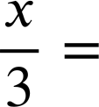
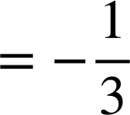
Maintaining equality while manipulating equations
Complete the equations in this diagram. The arrows show the operation that is being applied to the whole equation.
x + 1 = ____
______ = ____
+(−4)
+ (−5x)
______ = 35
____ + 1 = ____ + 5x
× 5
+ 1
x + 4 = ___
____ = 3 + 5x
+ 5x
+ 4
x = 3
×
____ = 9
× 3
____
+(−10)
+ (x + 1)
______ = −1
______ ….
______ =______
÷ 3

Slide 23
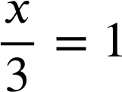
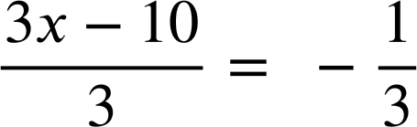
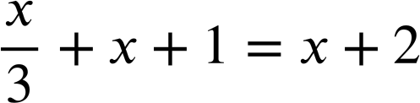
Maintaining equality while manipulating equations
Complete the equations in this diagram. The arrows show the operation that is being applied to the whole equation.
x + 1 = 4
5(x + 4)− 4 = 31
+(−4)
+ (−5x)
5(x + 4) = 35
6x + 1 = 4 + 5x
× 5
+ 1
x + 4 = 7
6x = 3 + 5x
+ 5x
+ 4
x = 3
×
3x = 9
× 3
+(−10)
+ (x + 1)
3x − 10 = −1
÷ 3

Slide 24
Many equations, one solution
Maintaining equality while manipulating equations
Generating equations with the same solution

Slide 25
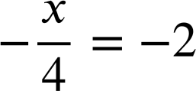
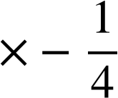
Generating equations with the same solution
If equations are equivalent, we can work out the operation which links them.
−5x = −40
× −5
÷ −4
x = 8
+ (x − 2)
+ 2x
+ 7
2x − 2 = x + 6
x + 7 = 15
3x = 2x + 8
What operation goes on each arrow?
All the operations produce equivalent equations but they have all changed the original equation in different ways.

Slide 26
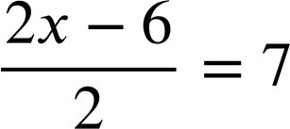
Generating equations with the same solution
Some operations will make the equation look more complicated, and some may make it look simpler.
What would the equations in this diagram look like?
Both terms divide nicely by 2 so we could write this as:
2x − 10 = 10
x − 3 = 7
÷ 2
+ (−4)
2x − 6 = 14
+ (−2x)
+ 6
× 2
4x − 12 = 28
2x = 20
2(2x − 6) = 28
or
− 6 = 14 − 2x

Slide 27
Generating equations with the same solution
Which operations seemed to make the equation more complicated?
You may have said + (−2x) or × 2
Are there any operations that seemed to make the equation simpler?
You may have said ÷ 2 or + 6
2x − 10 = 10
x − 3 = 7
÷ 2
+ (−4)
2x − 6 = 14
+ (−2x)
+ 6
× 2
2x = 20
4x − 12 = 28
− 6 = 14 − 2x

Slide 28

Generating equations with the same solution
Which equation do you think Andeep might have used to suggest this solution?
I think the solution might be when x is 10
All the equations will have the same solution as they are all equivalent.
However these two might be the simplest.
Andeep
2x − 10 = 10
x − 3 = 7
2x − 6 = 14
− 6 = 14 − 2x
4x − 12 = 28
2x = 20

Slide 29
Generating equations with the same solution
How could we check if Andeep is correct?
I think the solution might be when x is 10
Substitute x = 10 into any of the equations
(10) − 3 = 7
7 = 7
Andeep
x − 3 = 7
2(10) − 6 = 14
20 − 6 = 14
14 = 14
2x − 6 = 14
2(10) = 20
20 = 20
2x = 20
‘x is 10’ is a solution to all these equations.

Slide 30
Generating equations with the same solution
Here, the missing number in the centre of this diagram is representing the solution to all these equations.
3x = −6
2x + 1 = x − 1
+ (x + 1)
× 3
x = ..
× −1
+ 5
−x = 2
x + 5 = 3
What operation goes on each arm?
Do you think you know what the solution to all these equations are?
Let’s try some values to see.

Slide 31
Generating equations with the same solution
Here the missing number in the centre of this diagram is representing the solution to all these equations.
3x = −6
2x + 1 = x − 1
+ (x + 1)
× 3
x = ..
−2
× −1
+ 5
−x = 2
x + 5 = 3
If x = 1
(1) + 5 = 3
6 = 3
If x = 0
(0) + 5 = 3
5 = 3
If x = −2
(−2) + 5 = 3
3 = 3
We can check with other equations.
3(−2) = −6
−6 = −6
2(−2) + 1 = (−2) − 1
−4 + 1 = −3
−3 = −3

Slide 32
Generating equations with the same solution
Given that 20 = 10 − 2x, which of these are true?
a
2x + 20 = 10
2x has been added to both sides
1 has been added to the left but x + 1 has been added to the right
b
21 = 11 − x
x = 5 is a solution
20 = 10 − 2(5)
20 ≠ 10 −10
c
d
10 = − 2x
10 has been subtracted from both sides
40 = 30 − 2x
20 has been added to both sides
e

Slide 33
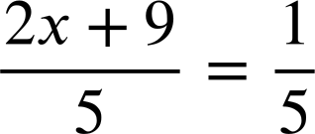

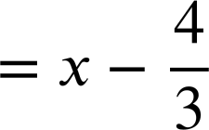
Generating equations with the same solution
Fill in the missing expressions and operations in this diagram.
6 = ____
×
+ (−x)
______ = 1
______ = 2
___
___
2x = ___
______ = 6
× 2
x =___
+ 10
+ 3x
______ = 3x − 4
___ =___
×
___
+ x
8x = 7x − 4
______ ........
______ = 7x
+ 4

Slide 34
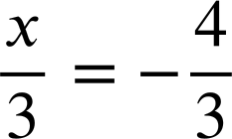
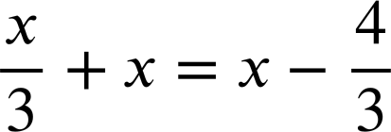
Generating equations with the same solution
Fill in the missing expressions and operations in this diagram.
6 = 2 − x
×
+ (−x)
2x + 9 = 1
x + 6 = 2
+ 9
+ (−4)
2x = − 8
x + 10 = 6
× 2
x = − 4
+ 10
+ 3x
4x = 3x − 4
×
+ x
+ 4x
8x = 7x − 4
8x + 4 = 7x
+ 4

Slide 35
Many equations, one solution.
Given a single value of a variable, we can write equivalent equations by applying the same operation to the expressions on both sides of the equals sign.
The solution to all the equivalent equations will be the same.
Some operations make the equation look more complicated and some may make it look simpler.
It is possible to perform operations which make the solution to the equation clear.

Slide 36

© Oak National Academy 2023.
Produced in partnership with Mathematics in Education and Industry.
Licensed on the Open Government Licence v3.0, except where otherwise stated. See Oak terms and conditions.

